Slide 1
Does a portrait need a face?
Session 2: Does a portrait need a face?

Slide 2
Part 1
Group discussion
Take a look at 3 different portraits and talk about them

Slide 3
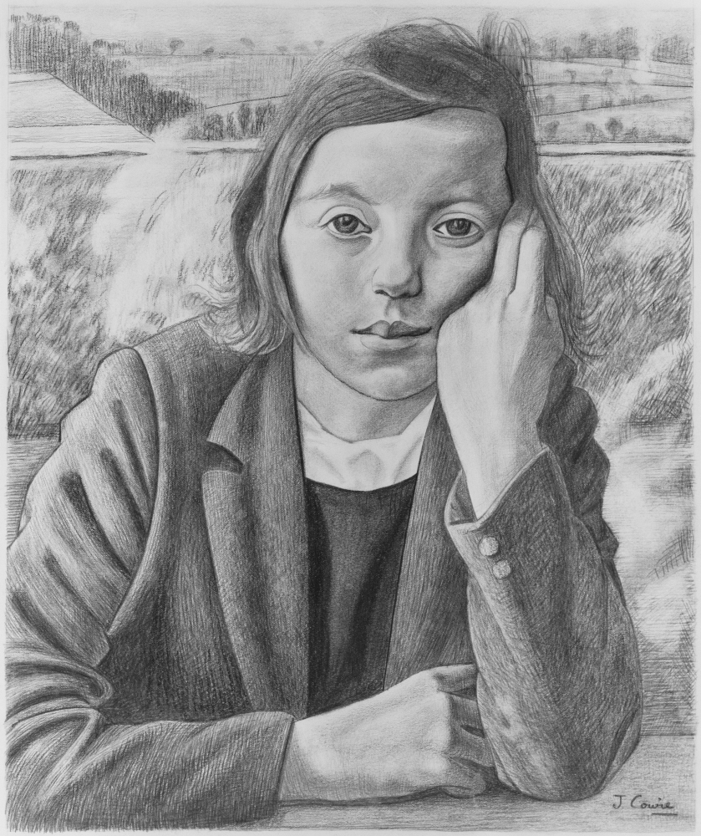
Part 1 Portrait 1
1. What do you see? 2. Can you tell anything about what this person is like? If so, what can you tell?
Notes:
Stimulus: Show one image at a time and ask the group:
What do you see?
Can you tell anything about what this person is like? If so, what do you think they are like?
Accept answers such as ‘not sure, it’s just a feeling’ (emergent: ‘can feelings tell us what things are?’ or ‘what can we learn from feelings?’) or ‘I don’t think you can tell anything about them’ - open up the latter (e.g. ‘can you say more about that?’).
Students may also have divergent views on the gender of the person in the third portrait. Allow them to express their ideas, and if a student is trying to refer to that person without committing themselves to deciding, you can suggest they talk about ‘the person’ and use ‘they’ pronouns.
This person does identify as a man, and you can choose whether or not you reveal this to the group. On one understanding of gender, you can’t tell someone’s gender by looking.

Slide 4
Part 1 Portrait 2
1. What do you see? 2. Can you tell anything about what this person is like? If so, what can you tell?
Notes:
Stimulus: Show one image at a time and ask the group:
What do you see?
Can you tell anything about what this person is like? If so, what do you think they are like?
Accept answers such as ‘not sure, it’s just a feeling’ (emergent: ‘can feelings tell us what things are?’ or ‘what can we learn from feelings?’) or ‘I don’t think you can tell anything about them’ - open up the latter (e.g. ‘can you say more about that?’).
Students may also have divergent views on the gender of the person in the third portrait. Allow them to express their ideas, and if a student is trying to refer to that person without committing themselves to deciding, you can suggest they talk about ‘the person’ and use ‘they’ pronouns.
This person does identify as a man, and you can choose whether or not you reveal this to the group. On one understanding of gender, you can’t tell someone’s gender by looking.

Slide 5
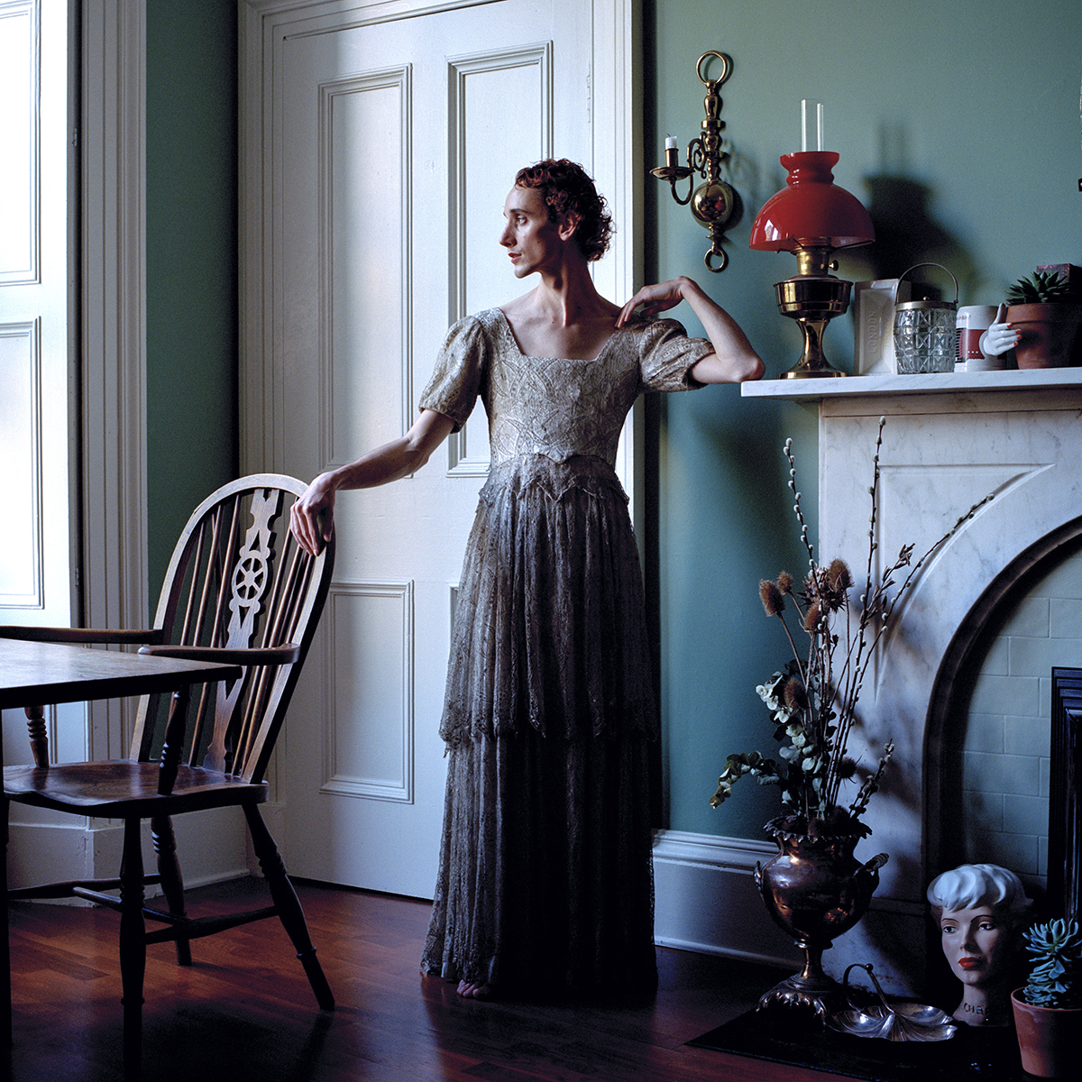
Part 1 Portrait 3
1. What do you see? 2. Can you tell anything about what this person is like? If so, what can you tell?
Notes:
Stimulus: Show one image at a time and ask the group:
What do you see?
Can you tell anything about what this person is like? If so, what do you think they are like?
Accept answers such as ‘not sure, it’s just a feeling’ (emergent: ‘can feelings tell us what things are?’ or ‘what can we learn from feelings?’) or ‘I don’t think you can tell anything about them’ - open up the latter (e.g. ‘can you say more about that?’).
Students may also have divergent views on the gender of the person in the third portrait. Allow them to express their ideas, and if a student is trying to refer to that person without committing themselves to deciding, you can suggest they talk about ‘the person’ and use ‘they’ pronouns.
This person does identify as a man, and you can choose whether or not you reveal this to the group. On one understanding of gender, you can’t tell someone’s gender by looking.

Slide 6
Part 1
What can you tell about a person from looking at a portrait?
Notes:
Allow them to talk in pairs for 2 minutes before asking the whole group.
Possible nested questions
What tells us more about someone,
Their face
Their body,
Their clothes,
The objects around them,
Their location
The colours used in the portrait?
What can’t a portrait tell you about a person?
Can you tell anything about someone from their portrait?
Possible emergent questions
Does a portrait tell us about a person or a scenario?
Can a portrait tell you about something other than a person?
Can a portrait tell you anything about the artist who made it?

Slide 7
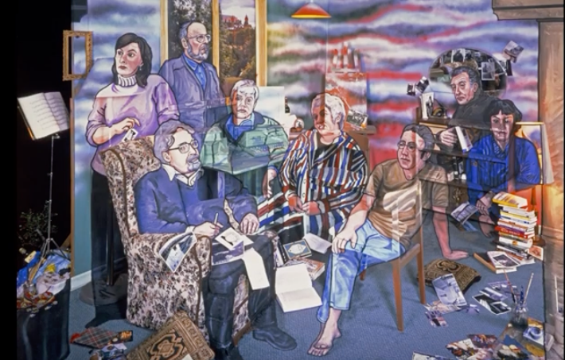
Part 2
Watch this video to introduce the next task:
Does a portrait need a face?
Notes:
Allow them to talk in pairs for 2 minutes before asking the whole group.
Possible nested questions
What tells us more about someone,
Their face
Their body,
Their clothes,
The objects around them,
Their location
The colours used in the portrait?
What can’t a portrait tell you about a person?
Can you tell anything about someone from their portrait?
Possible emergent questions
Does a portrait tell us about a person or a scenario?
Can a portrait tell you about something other than a person?
Can a portrait tell you anything about the artist who made it?

Slide 8
Part 2
Choose between:
Make a portrait or self-portrait.
Decide whether to include a face, objects, a background.
Draw a comic strip of one of the people in the portraits you saw earlier.
Write a story about one of the people in the portraits you saw earlier.
Use your imagination!
Notes:
Allow your students to choose between:
Making a self-portrait. Encourage them to think about how best to show themselves eg with a face or not, with objects, a location that is meaningful to them; what materials they will choose (2D or 3D, photo / paint / drawing / sculpture), colours, size
Drawing a comic strip of one of the people in the images above
Writing a story about one of the people in the images above
Encourage students to look at each others’ work, before and after completion. Invite them to comment on what they notice or like about each other’s work.

Slide 9
Part 3 Socratic Circle
Did you learn something when drawing or writing?
Notes:
Possible nested questions:
Does drawing something change how you think/feel?
Do you learn through looking carefully?
Does creativity help us think? Possible emergent questions:
Is it important to look?
Is it important to tell stories?
What makes us good/bad at something? How can we tell?

Slide 10
Image credits:
Angela Palmer, Susie Wolff: Portrait of a Racing Driver. 2018 © Angela Palmer
James Cowie, Schoolgirl (Study for ‘A Portrait Group’) © Ruth Christie, the artist's daughter
Craig Waddell, Samuel Froggatt. 2020 © Craig Waddell

