Slide 1
Notes for the group leader
About this resource
This resource is intended for use with learners aged 3-18 years.
Pick and choose which content suits your learners
Choose how much time to spend - from one lesson, to a whole term of experimentation
Edit this slide show to suit.
This resource includes:
a challenge question to inspire groups to come up with ideas for making art
prompts to nurture creativity skills through a three-step creative thinking process used by artists and designers: THINK WONDER CREATE
short videos demonstrating artists’ creative processes
an online gallery where you can share your groups’ creations with the world. You can share 2D, 3D, video, audio or text files: we welcome all kinds of art.

Slide 2
Notes for the group leader
Learner voice and choice
Your Art World aims to give children and young people a voice and encourages them to identify and explore themes that matter to them. We encourage you to offer choice at every stage, in order to motivate learners and promote independent and creative thinking.
This slide show focuses on the Question challenge:
I wonder what would happen if different creatures were mixed together?
This challenge was set by P7 children in Granton Primary, Edinburgh. It is intended as a starting point to help learners generate ideas and to identify their own interests.
If your group would like to suggest one of the future challenges please contact learning@nationalgalleries.org
We’d love to hear their suggestions!

Slide 3
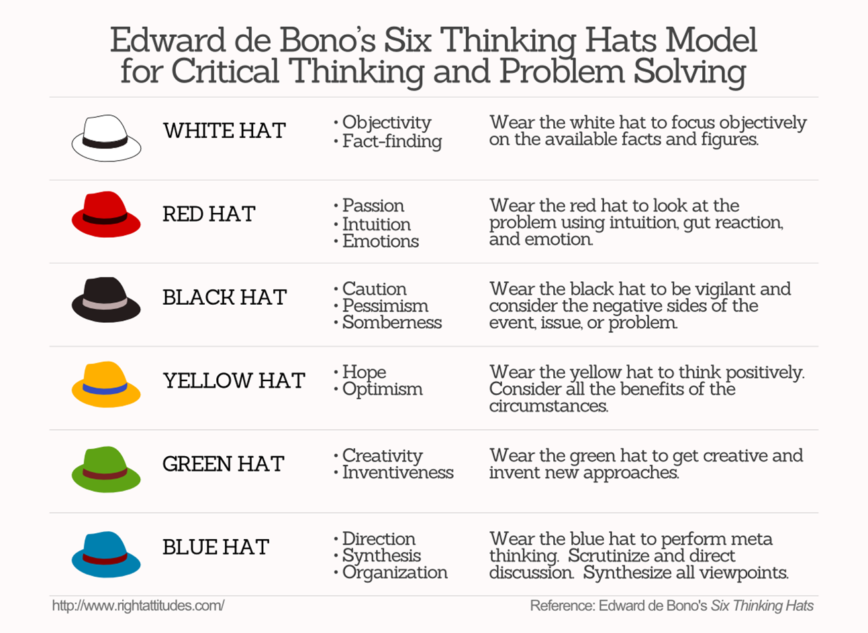
Notes for the group leader
We’ve taken inspiration from Edward de Bono’s
Six Thinking Hats model, which helps generate new ideas by challenging groups to consider different perspectives.

Slide 4
Notes for the group leader
Experiences and Outcomes for planning learning, teaching and assessment
I have the opportunity to choose and explore a range of media and technologies to create images and objects, discovering their effects and suitability for specific tasks. EXA 1-02a/EXA 2-02a
I can create and present work using the visual elements of line, shape, form, colour, tone, pattern and texture.
EXA 1-03a. / I can create and present work that shows developing skill in using the visual elements and concepts.
EXA 2-03a
I can create a range of visual information through observing and recording from my experiences across the curriculum. EXA 1-04a
Inspired by a range of stimuli, I can express and communicate my ideas, thoughts and feelings through activities within art and design. EXA 1-05a/EXA 2-05a
I can develop and communicate my ideas, demonstrating imagination and presenting at least one possible
solution to a design problem. EXA 2-06a
I am developing confidence when engaging with others within and beyond my place of learning. I can communicate in a clear, expressive way and I am learning to select and organise resources independently.
LIT 2-10a / LIT 3-10a
I regularly select and listen to or watch texts which I enjoy and find interesting, and I can explain why I prefer certain sources. I regularly select subject, purpose, format and resources to create texts of my choice.
LIT 1-01a/LIT 2-01a
I can convey information, describe events, explain processes or combine ideas in different ways. LIT 2-28a
Inspired by a range of stimuli, I can express my ideas, thoughts and feelings through drama. EXA 1-13a
I have developed confidence and skills in creating and presenting drama which explores real and imaginary situations, using improvisation and script. EXA 1-14a

Slide 5
Welcome to Your Art World
where you get to decide what kind of art you want to make…
and share it with the world…
Notes:
The full online resource can be found here: Your Art World | National Galleries of Scotland

Slide 6
You have chosen the question challenge…
Make art inspired by the question:
I wonder what would happen if different creatures were mixed together?

Slide 7
Artists are inspired by all kinds of things:
nature, people, places, objects, stories,
ideas and problems…
We want you to make art about something that inspires you.
It can be 2D, 3D, sound, video,
or creative writing.
Use the question as a starting point and
see where your imagination takes you…

Slide 8
We’re going to follow a three-step creative thinking process….
THINK WONDER CREATE

Slide 9
Step 1 THINK

Slide 10
Look at other art for inspiration
Think about the question in different ways
Start to grow your own ideas
Start to sketch ideas
Step 1 THINK

Slide 11
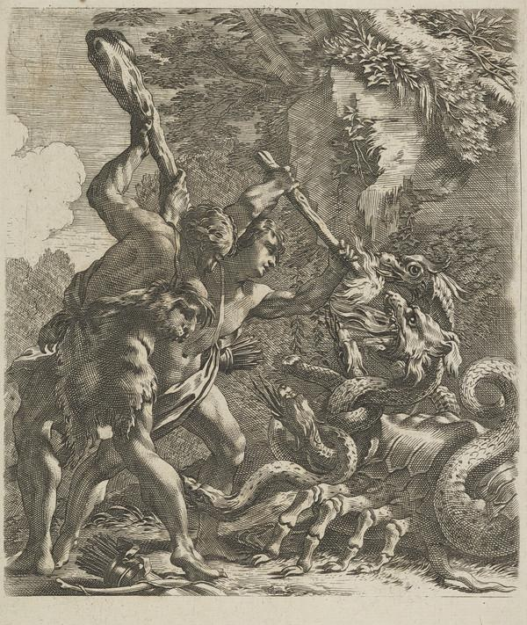
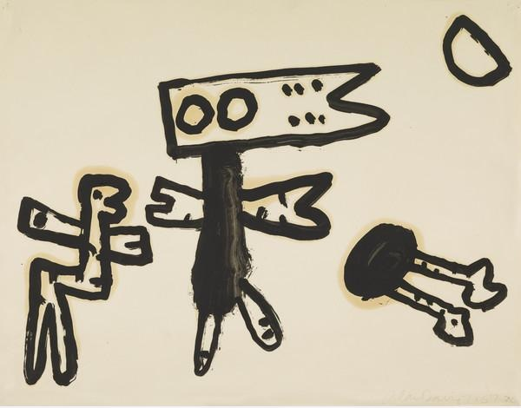
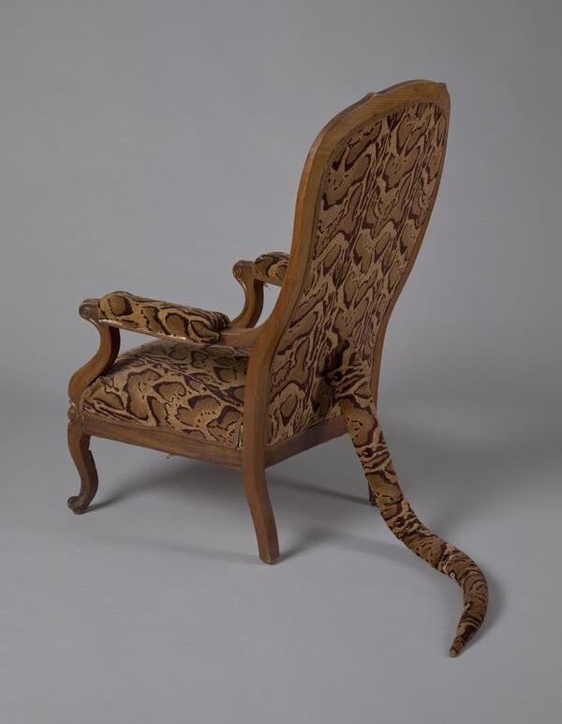
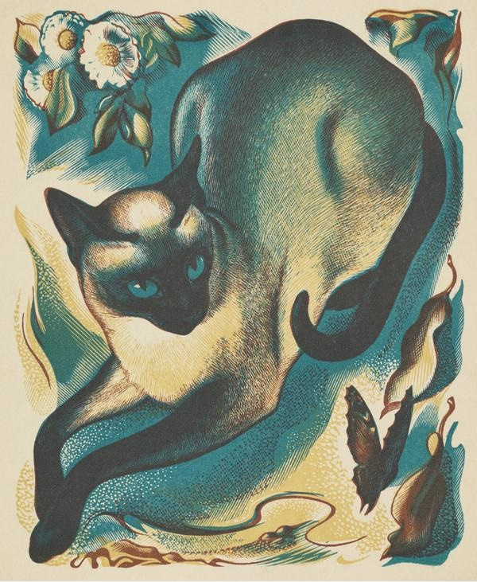
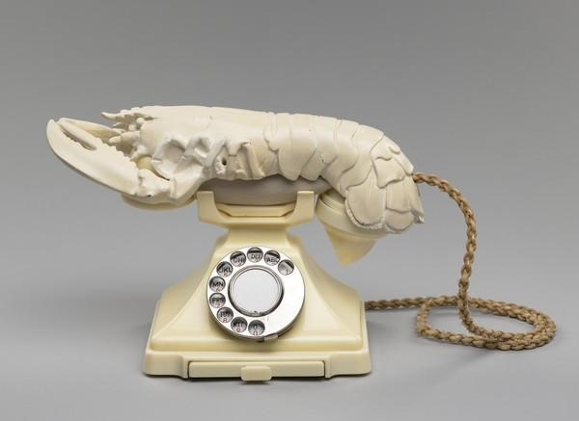
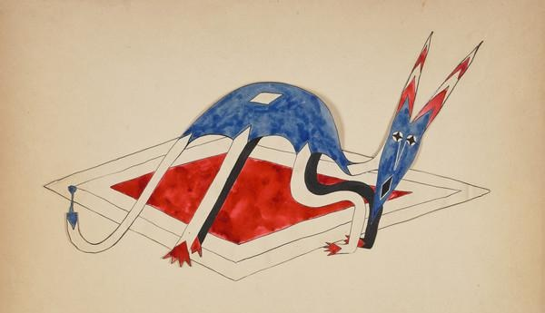
Here are some artworks from the National Galleries of Scotland.
What do you see? What do they make you think about?

Slide 12
Click the links to zoom in or find out more about the artworks on the previous slide
Michel Dorigny, Hercules fighting the Lernaean Hydra
Alan Davie, Moon Creatures
Dorothea Tanning, Primitive Seating
Agnes Miller Parker, Siamese Cat and Butterfly
Salvador Dali and Edward James, Lobster Telephone
Catherine Yarrow, Long Eared Creature (Morges)

Slide 13
Watch this short video to find out how P7 at Granton Primary in Edinburgh came up with the question challenge

Slide 14
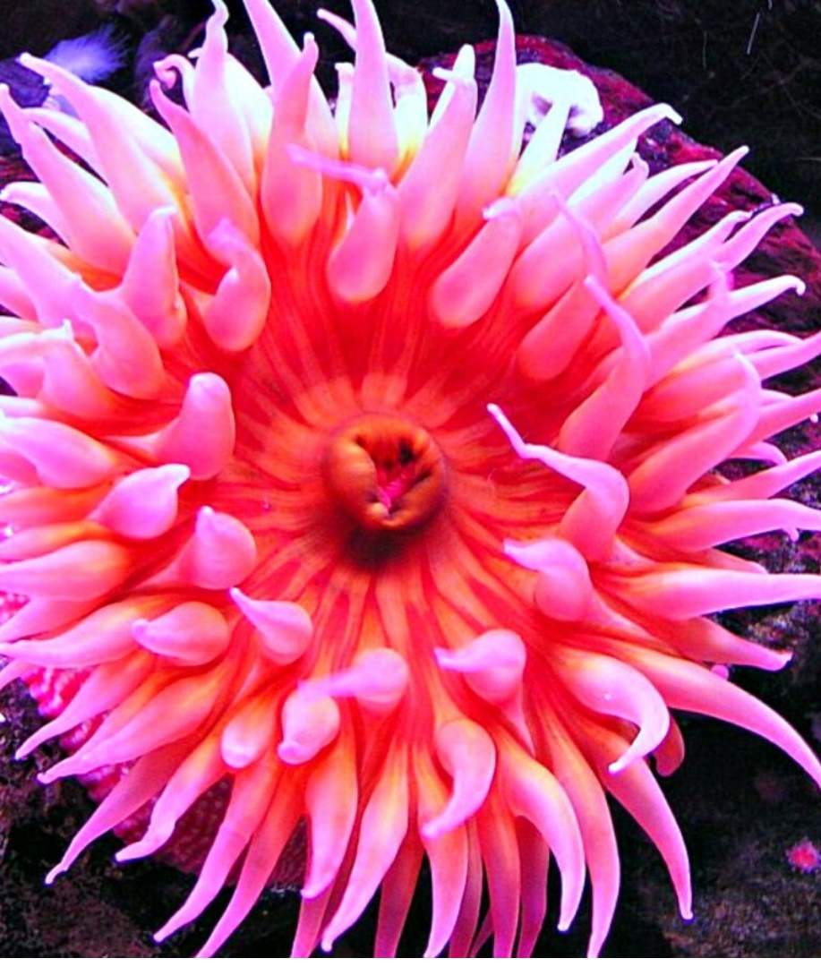
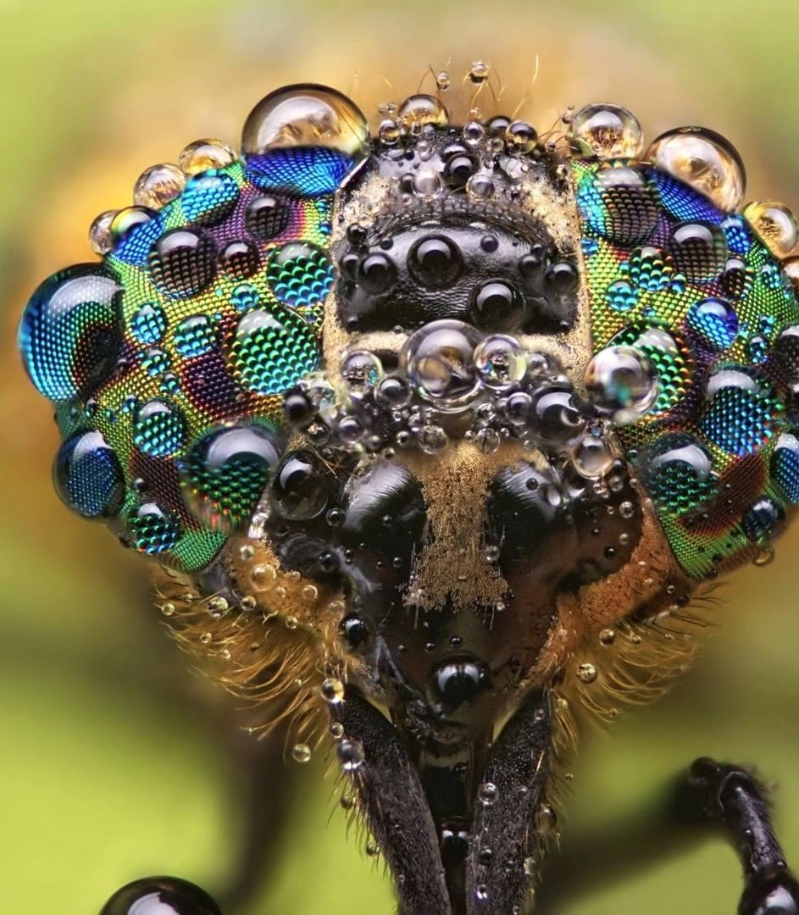
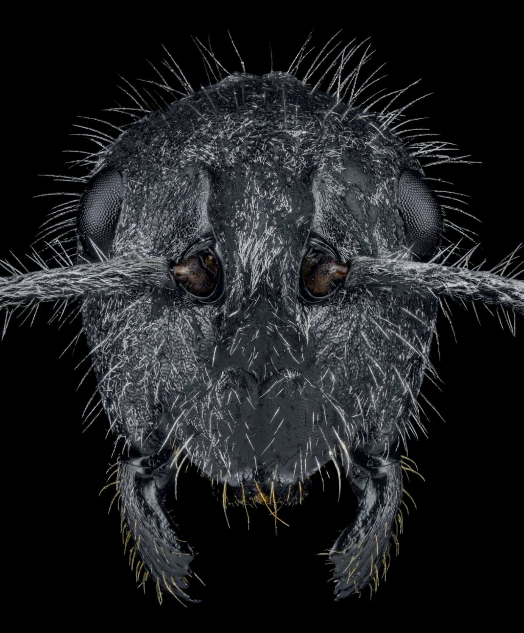
Share your knowledge…
What’s your favourite and least favourite creature? What do you know about them?
What questions do you have about them? How could you find answers to your questions?

Slide 15
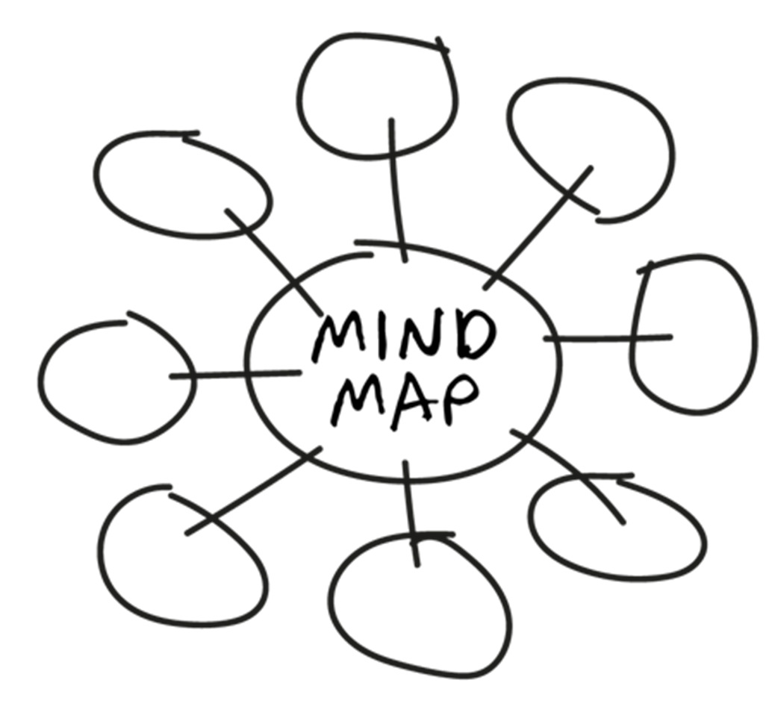
Draw, collage or make a mind map of as many different creatures as you can think of

Slide 16
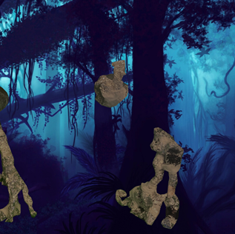
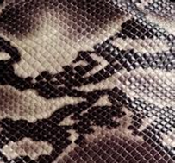
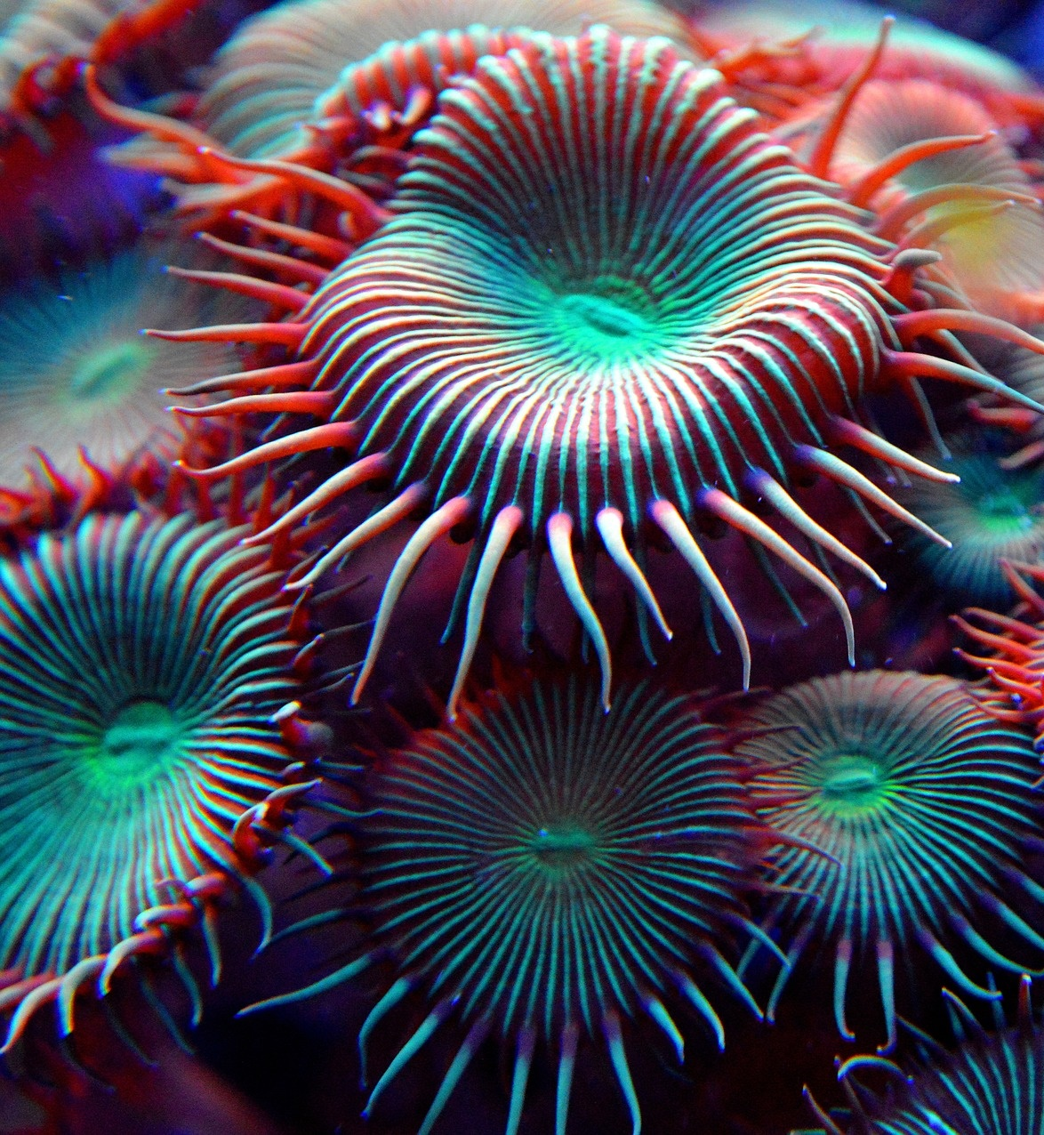
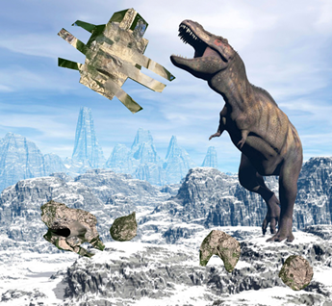
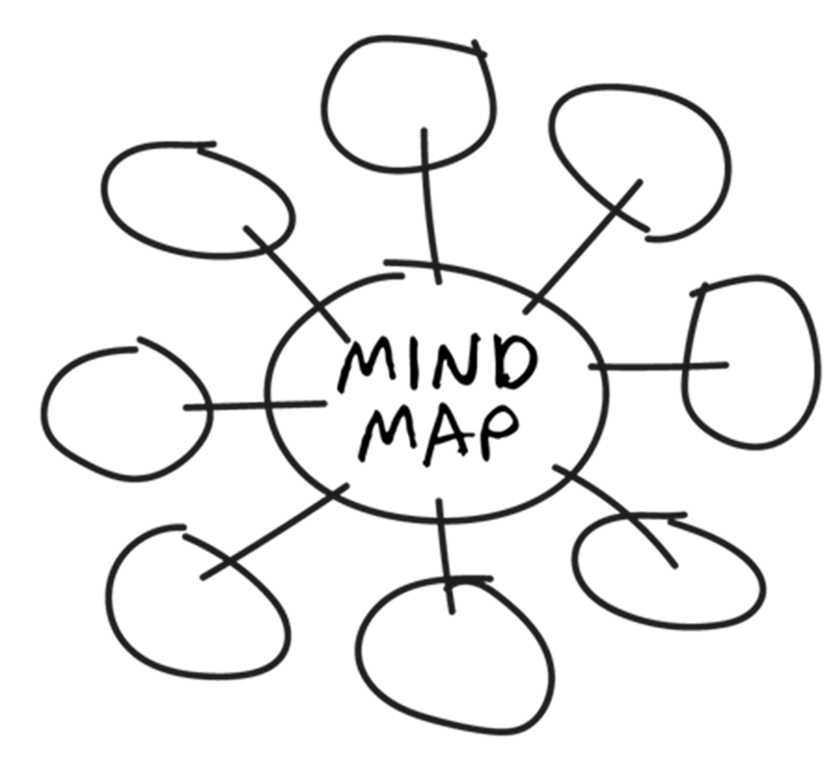
Draw, collage or make a mind map of as many different…
body shapes…
skin textures…
habitats…
super powers…as you can think of

Slide 17
Compare ideas
Which creatures, body shapes, skin textures, habitats or superpowers would you mix together?
What could happen?

Slide 18
Think of your own questions about creatures…

Slide 19
Turn your top 3 ideas into pictures, 3D models, stories or even sounds!
Quickly sketch or make models.
Don’t spend too long – this is just about capturing your ideas.

Slide 20
Step 2 WONDER

Slide 21
Step 2 is all about CREATIVE PLAY
Find out how an artist plays with ideas
Share ideas as a group and select the best ideas
Experiment with materials
Step 2 WONDER

Slide 22
Watch this video by artist Constant Vigier to find out how he got inspired by the question…

Slide 23
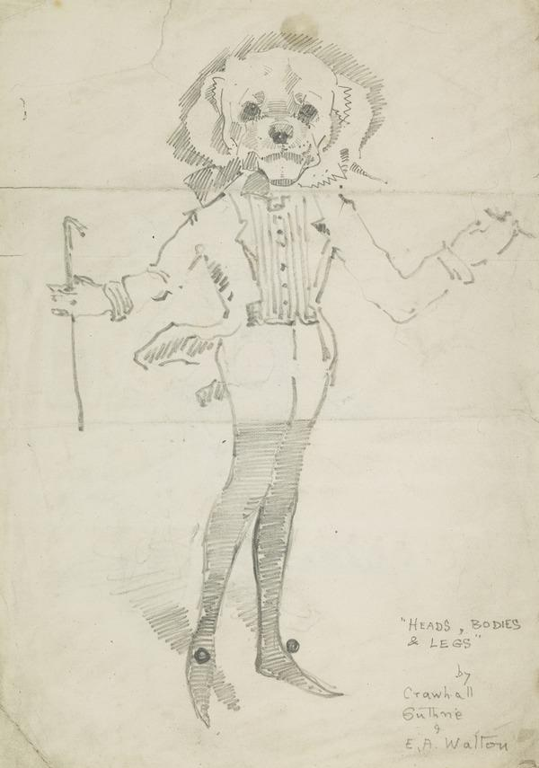
Experiment…
In a group of 3, play a game of Heads, Bodies and Legs.
Each person draws a head and neck, then folds their paper so only the neck is visible and passes it to the next person.
2. Draw a body attached to the neck. Fold the paper so only the top of the legs are visible and pass to the next person.
3. Draw the legs and feet.

Slide 24
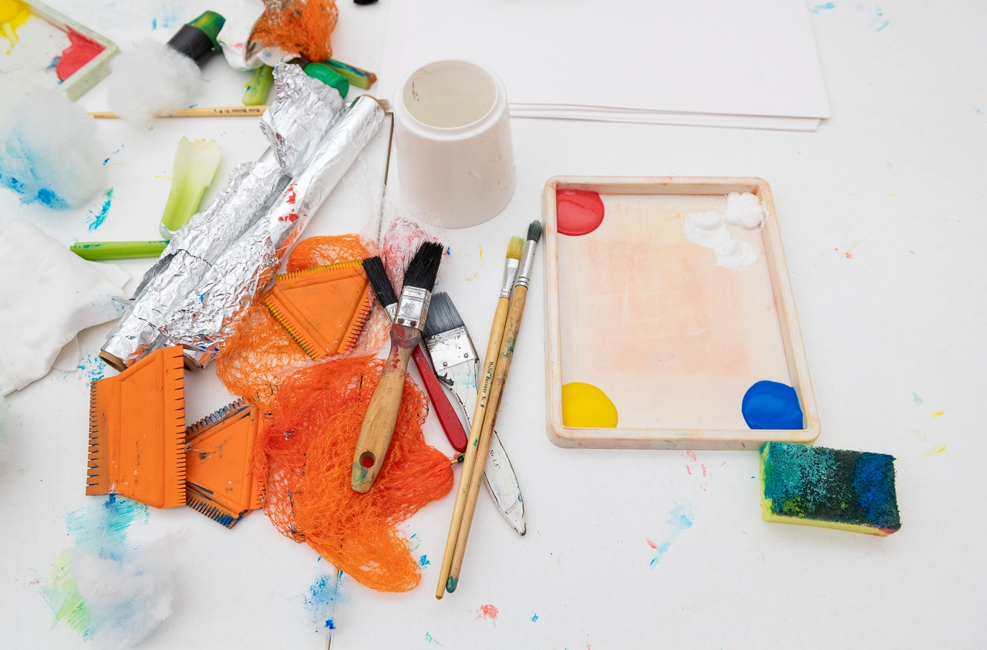
Experiment…
Try using
different materials
to create
animal skin
textures

Slide 25
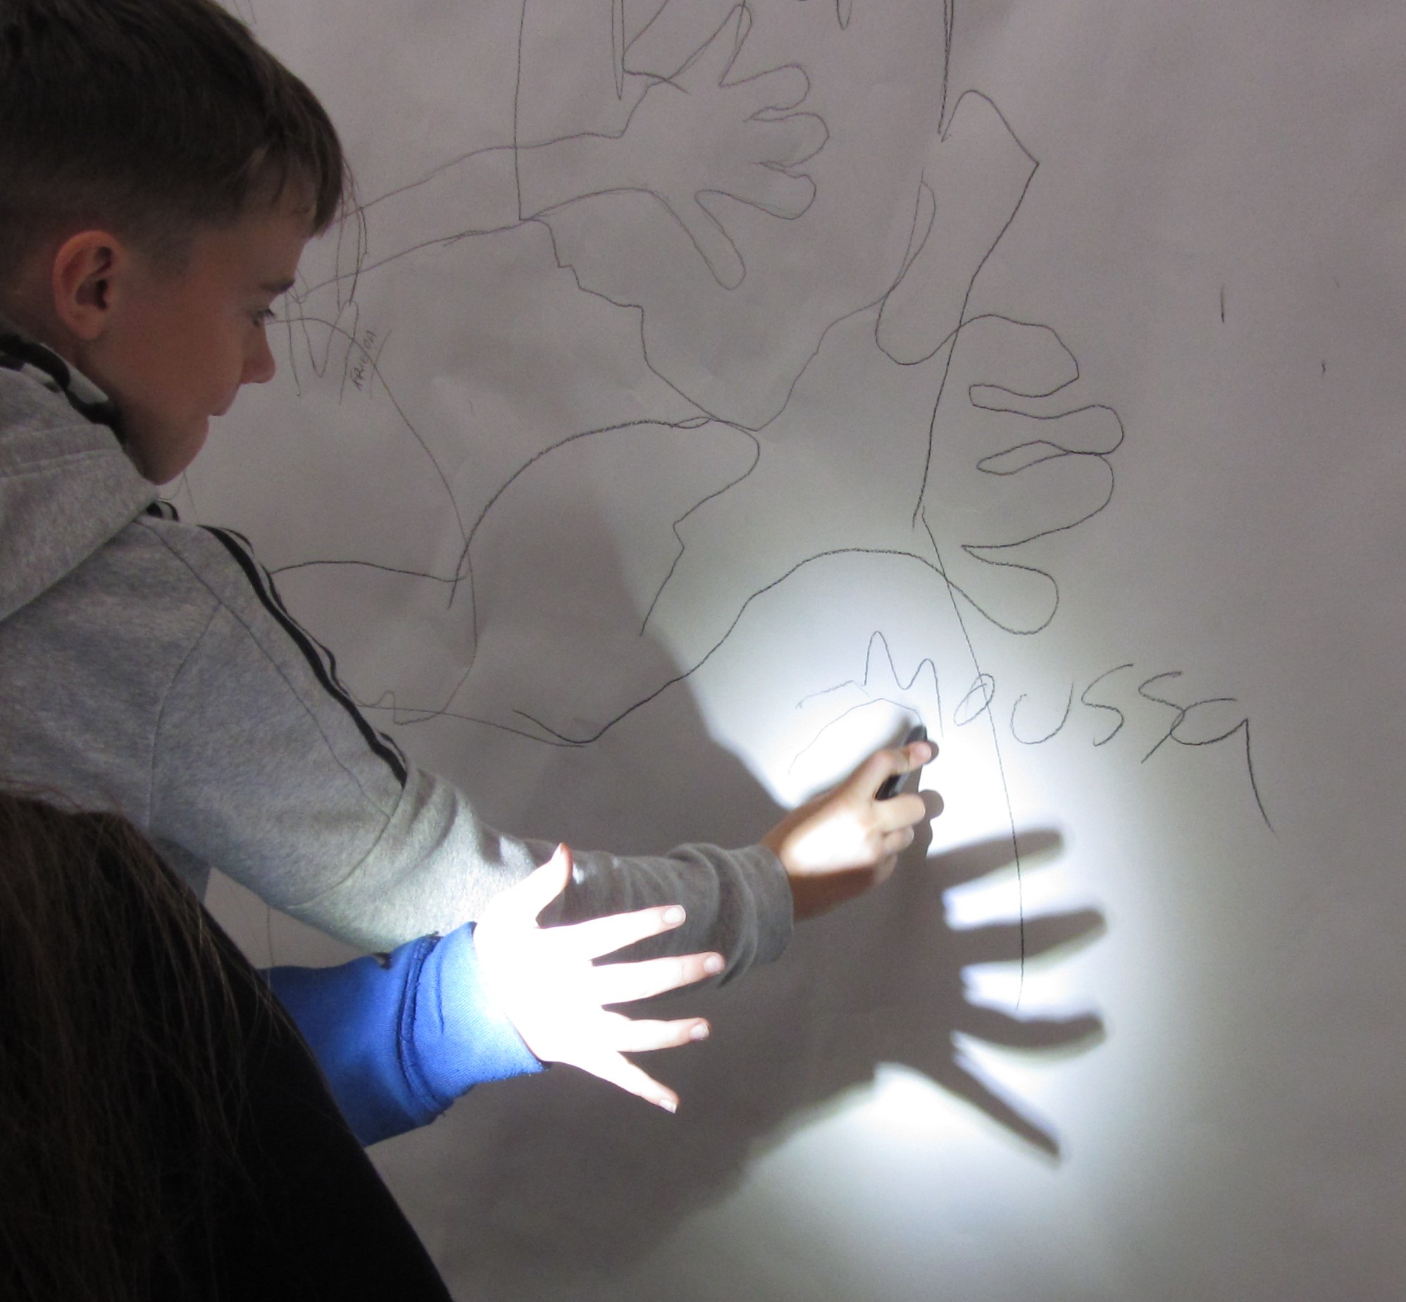
Experiment…
Try using a torch to invent new shadow creatures

Slide 26
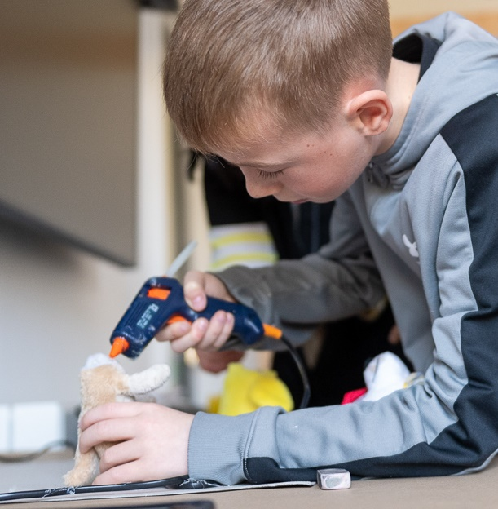
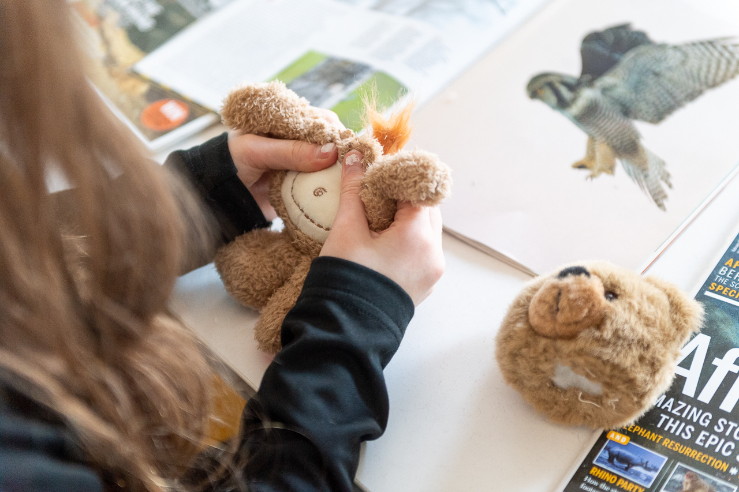
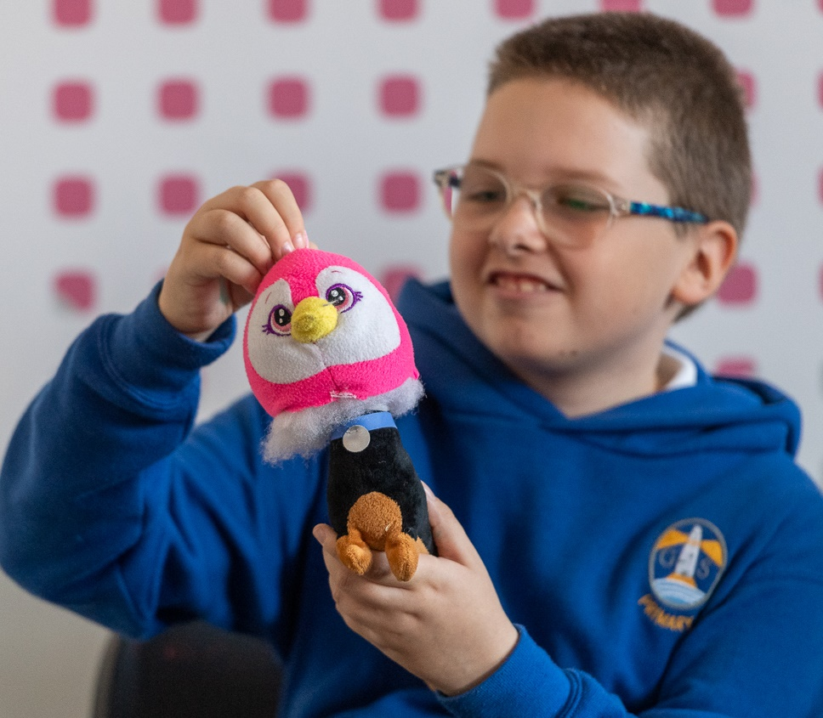
Experiment…
Recycle old toys to create new creatures
Step 1 Cut the head off
Step 2 Attach a new head!

Slide 27
Take a look at everything your group has made so far.
Which ideas do you think are the most creative, exciting, unusual?
What could you do next…?
Choose one or more ideas
Experiment with different materials to find the best way to create your idea
Notes:
Children have told us they find it easier to come up with ideas in a group. Sharing ideas is part of the creative process.

Slide 28
Not sure what materials to use?
Watch a video for ideas to help you experiment with materials…
Notes:
Each video explores a different material: charcoal / pencil, ink, cardboard, 3D, outdoor art.

Slide 29
Step 3 CREATE
Notes:
Steps 1,2 & 3 can be repeated as often as you like. We hope you enjoy the process of experimenting and creative play.

Slide 30
Reflect on everything you’ve done
Make your best idea into art
Share your art with the world
Step 3 CREATE

Slide 31
Lay out all your experiments. What do you think is the most creative, exciting or unusual idea? Decide how you will make this into your final artwork.

Slide 32
Remember your art can be 2D, 3D, sound, video or creative writing. It can be any shape or size.

Slide 33
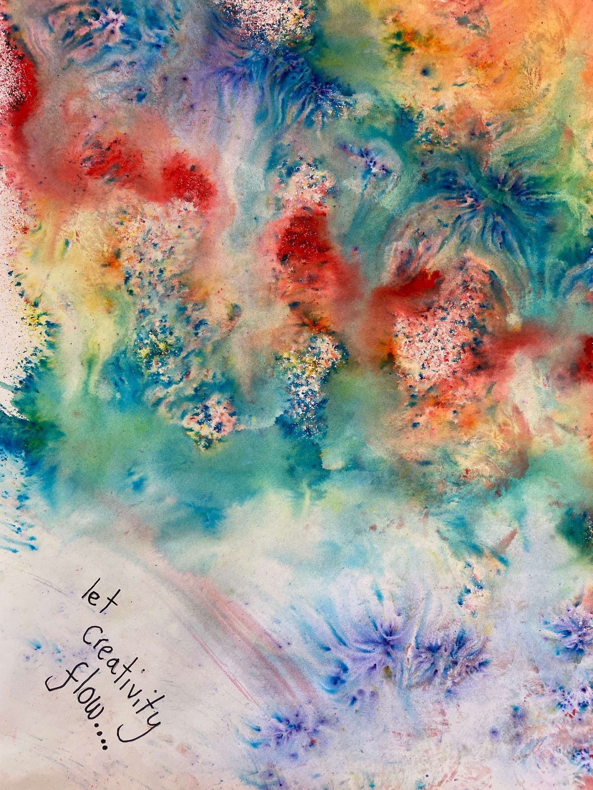
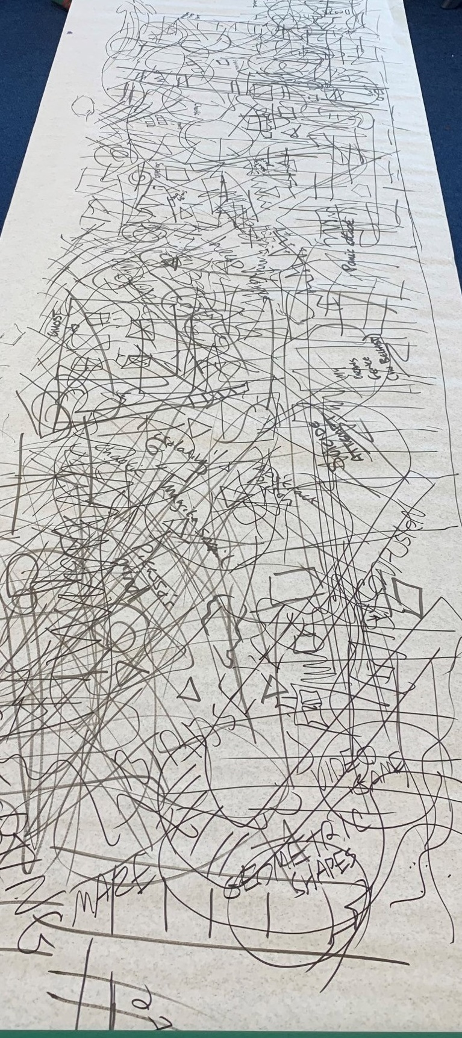
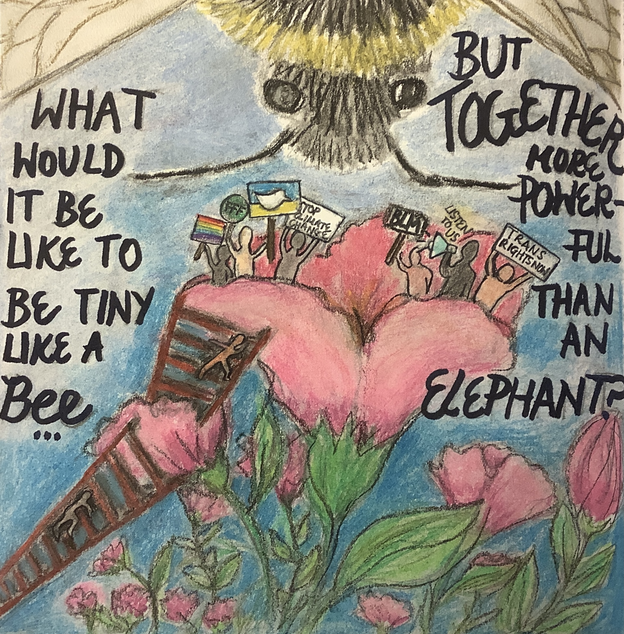
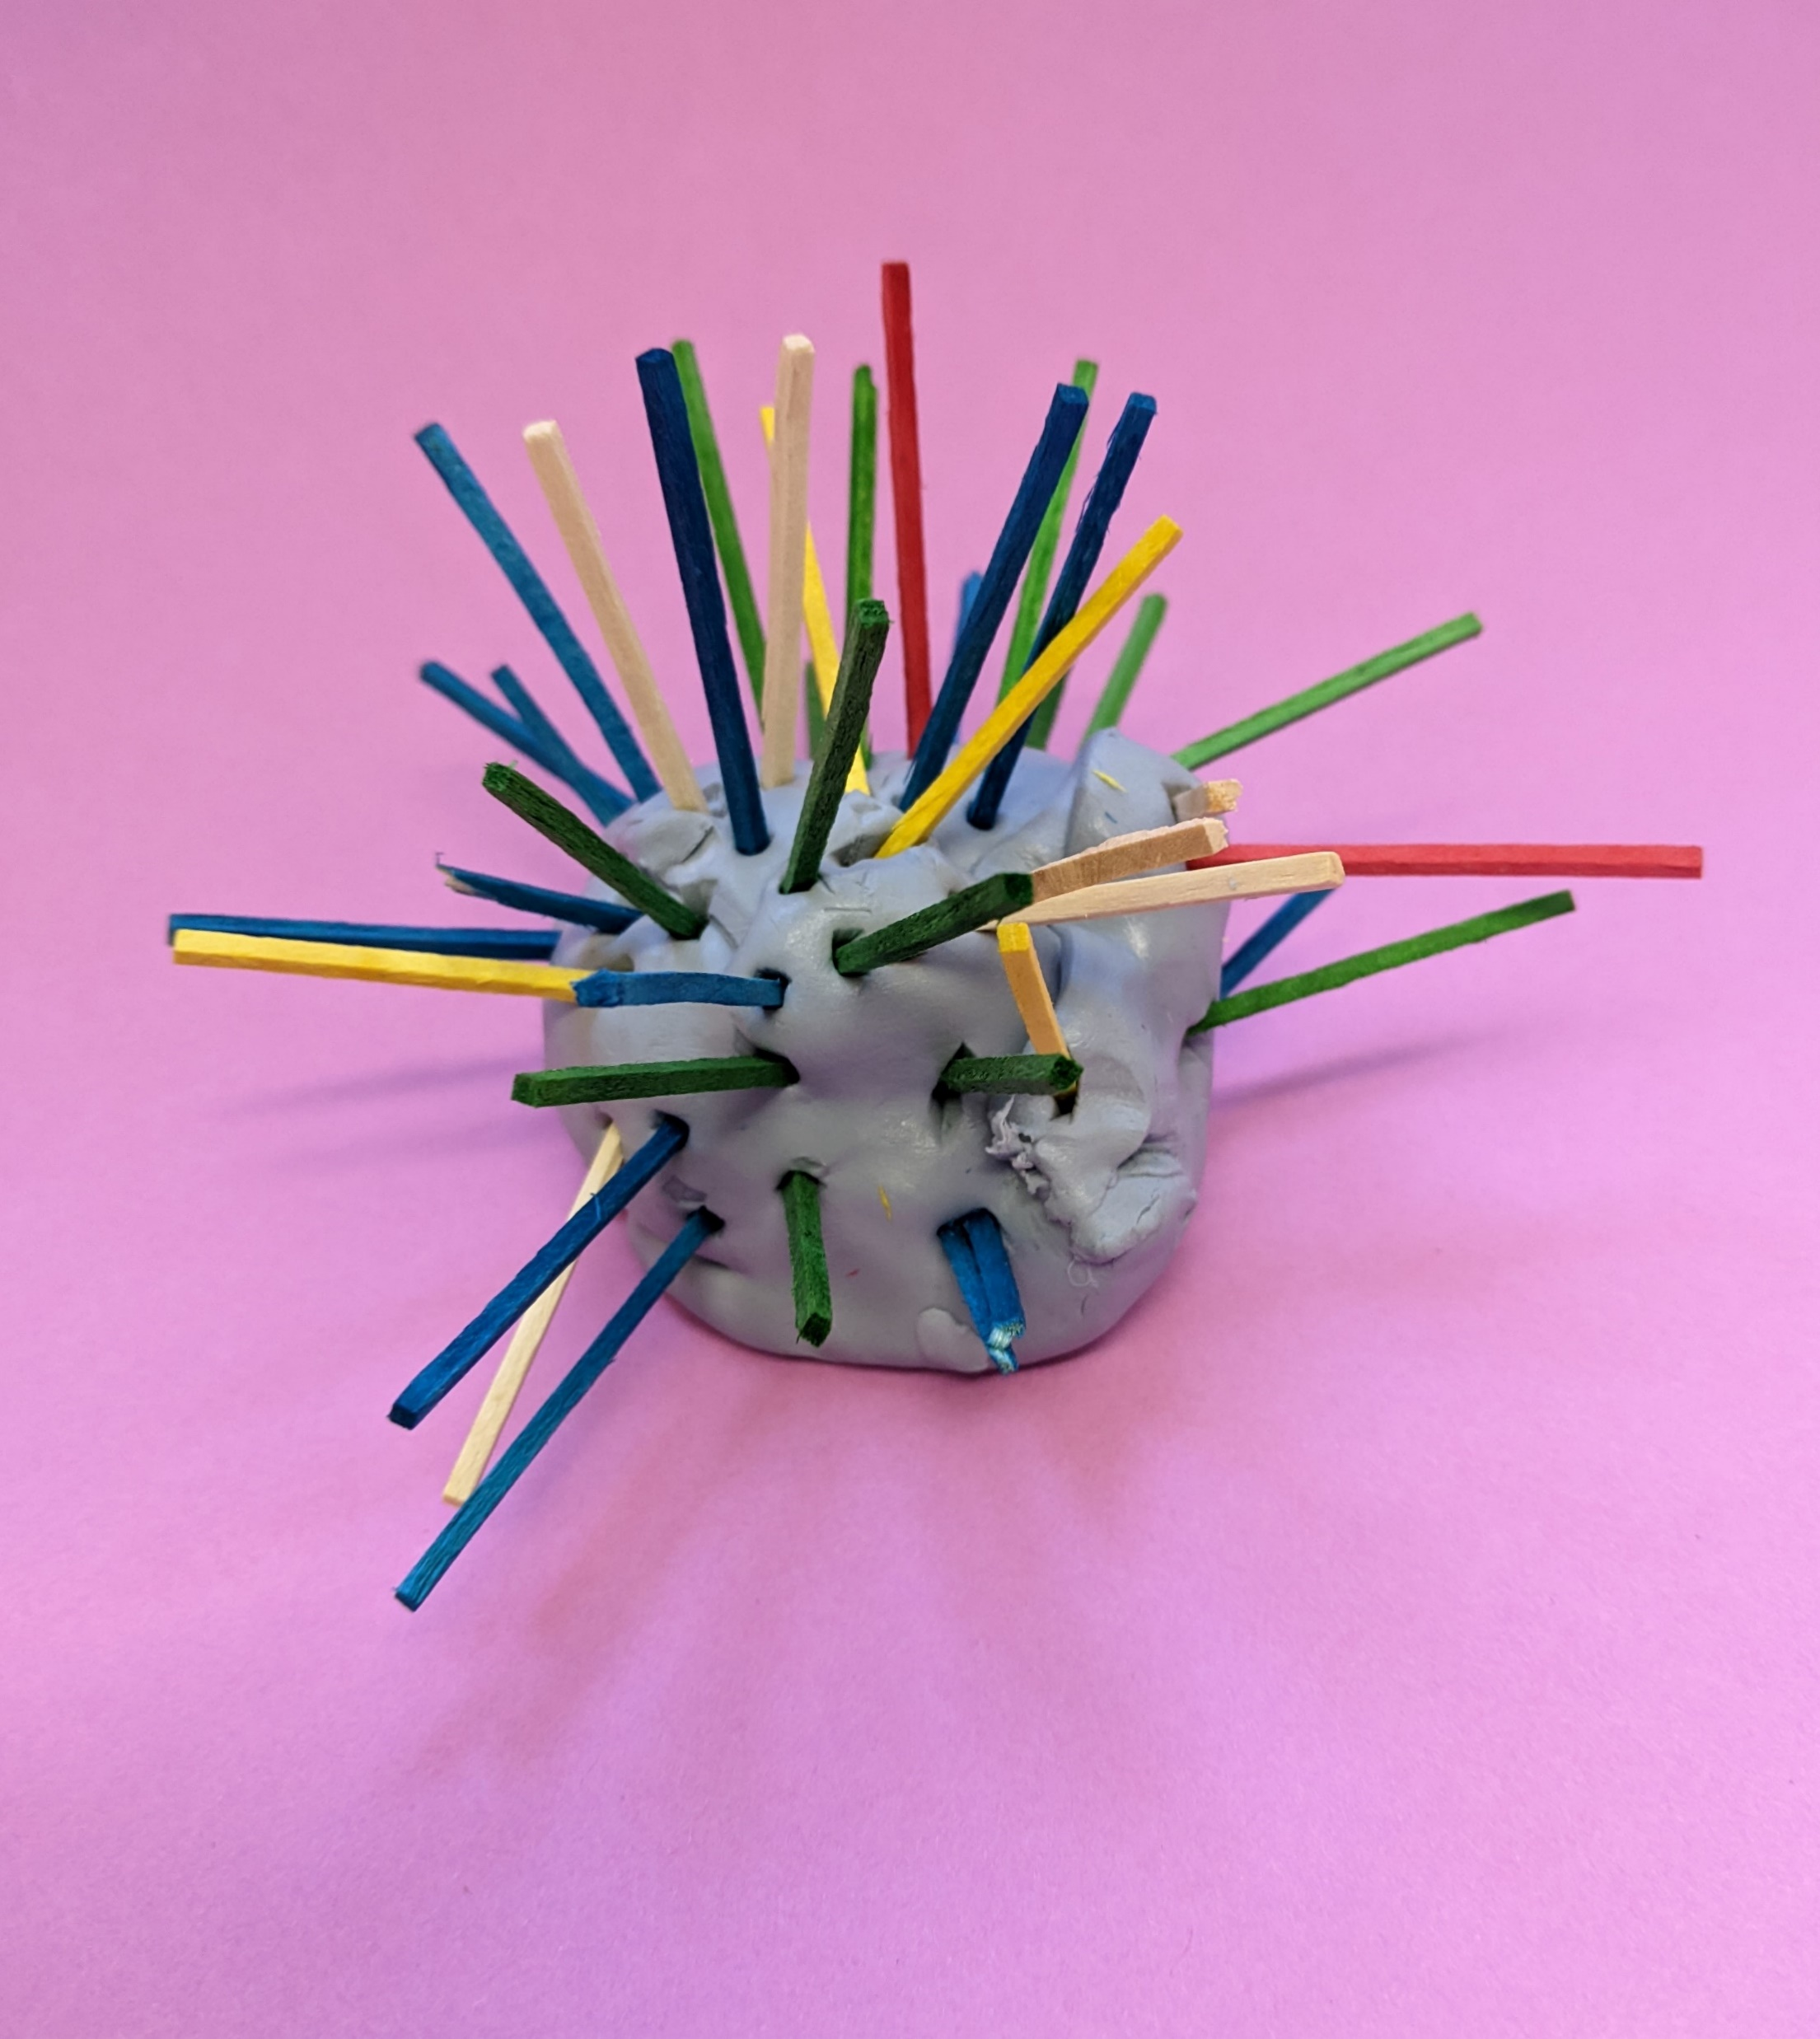
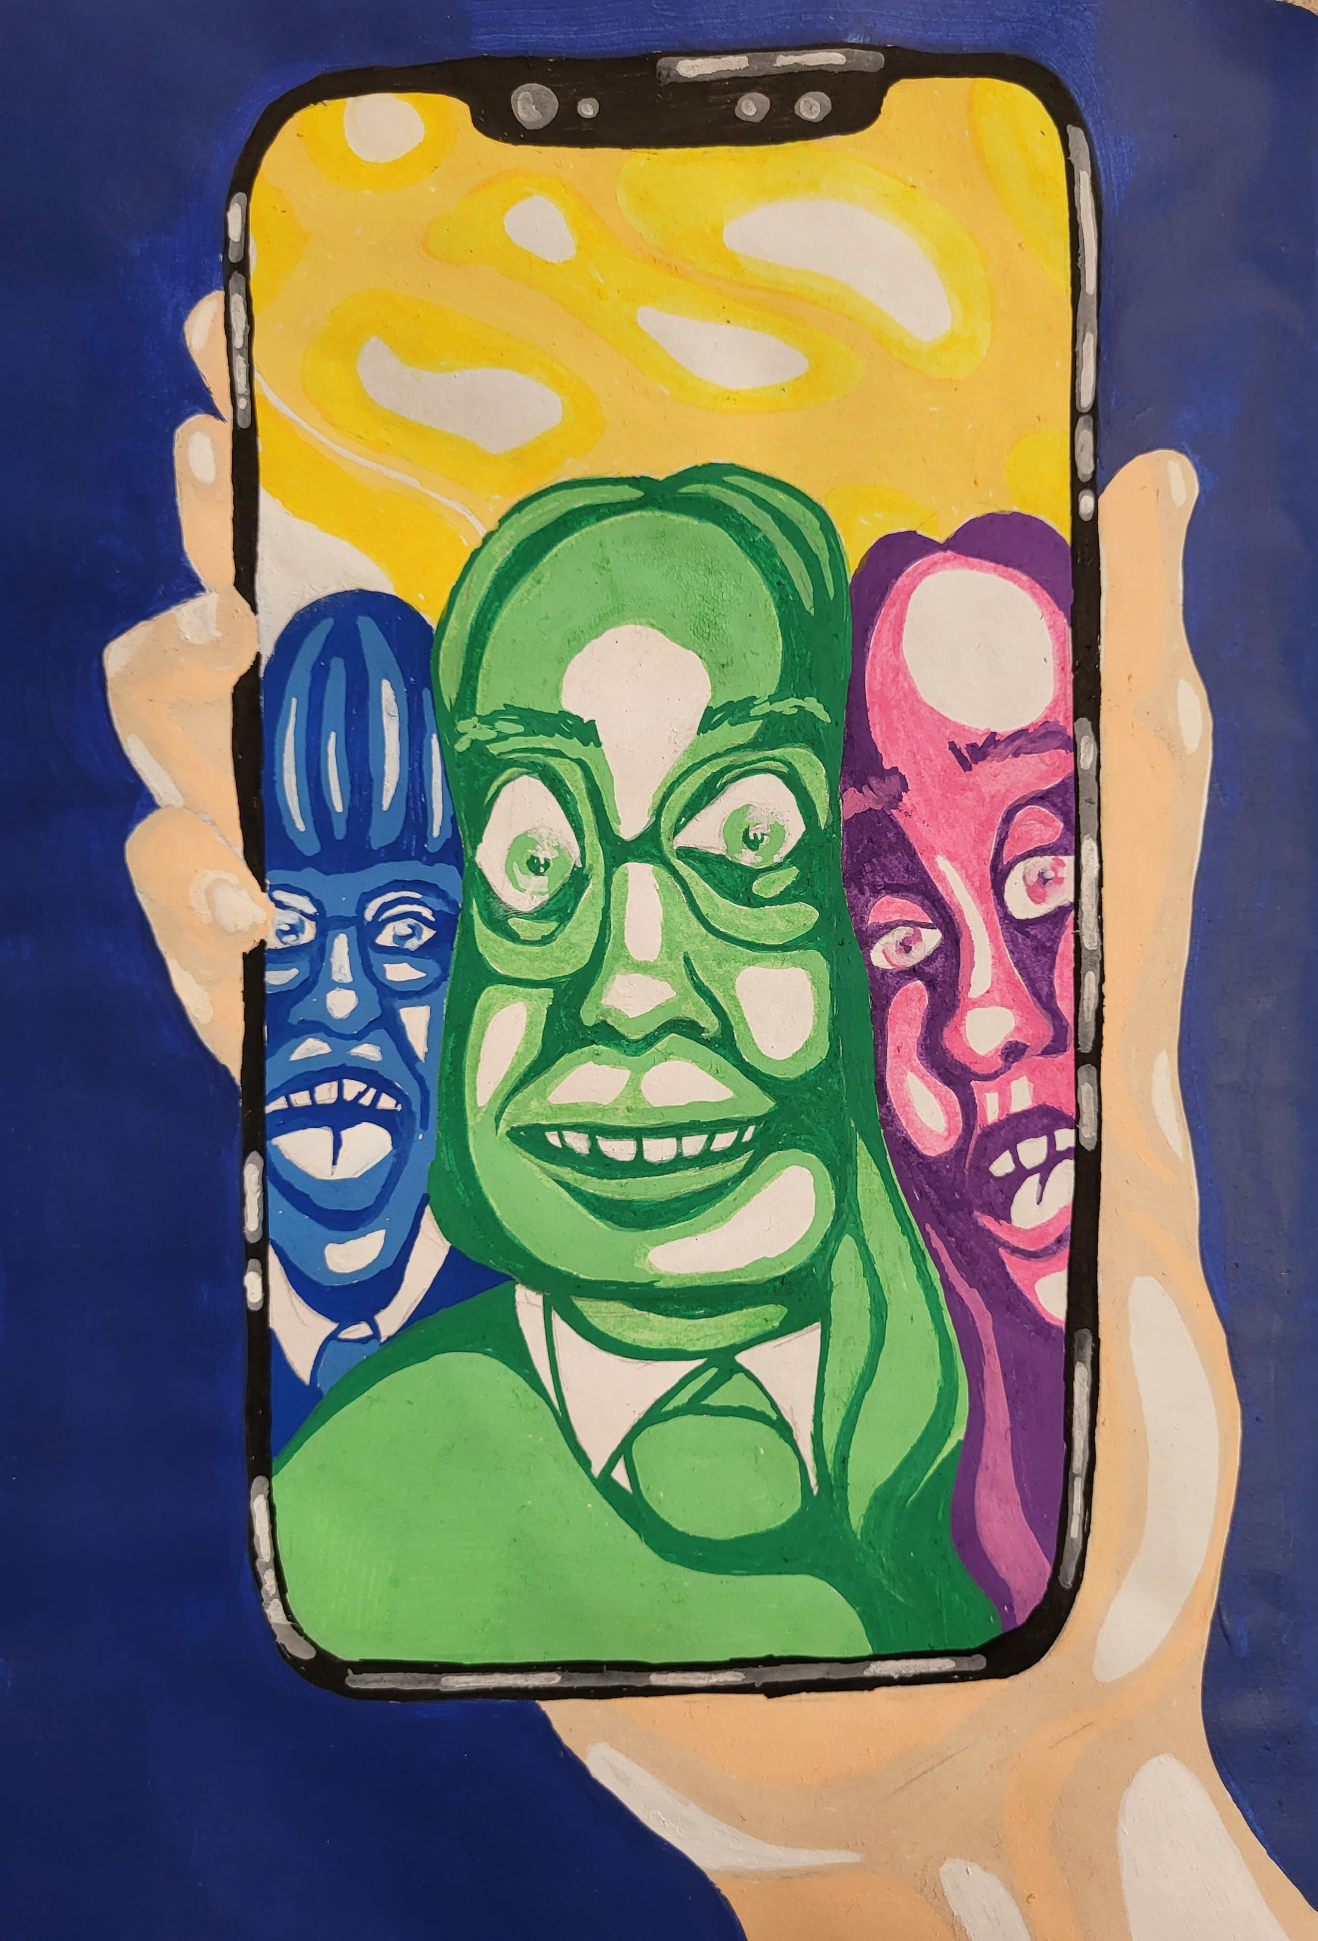
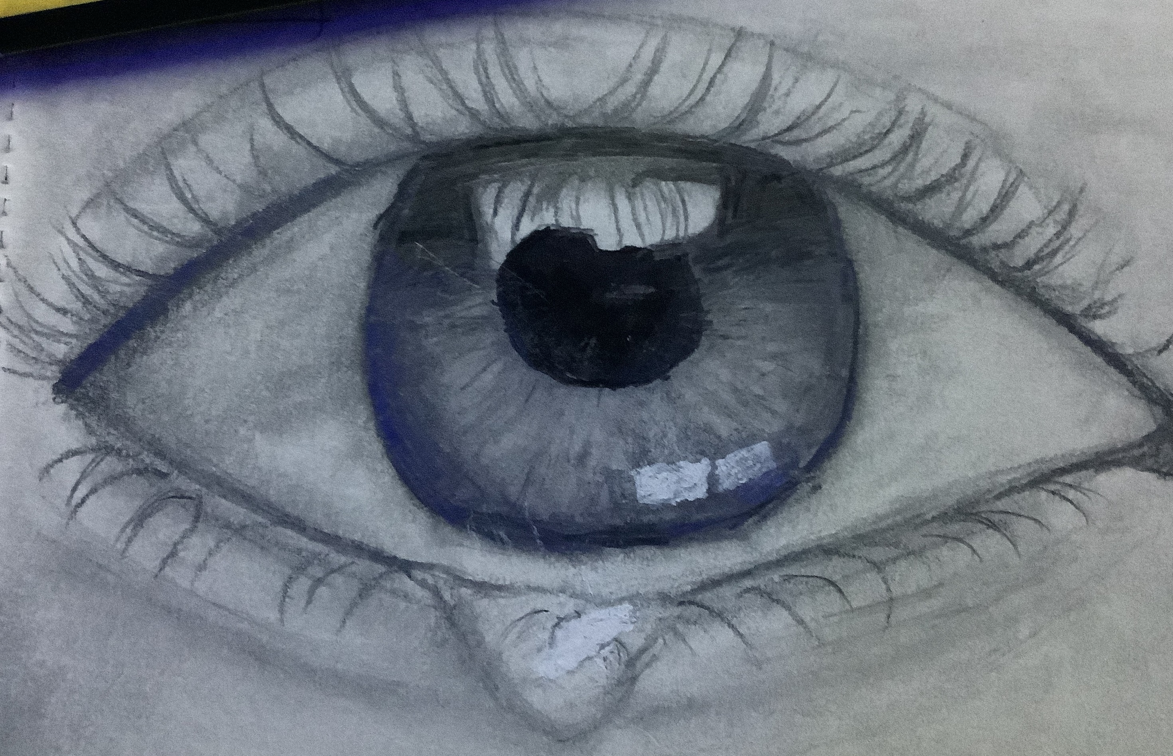
Check out the online gallery for more inspiration
Notes:
The online gallery in non-competitive – all entries will be shown. You could win £100 of art materials by taking part. We’re also planning the first in gallery exhibition in Edinburgh for 2023. We’d love to have all local authorities in Scotland take part.

Slide 34
Share your art in the online gallery
The deadline for you to send us your art is 7 January 2024.
We will add your art to the gallery as soon as we can.
Remember that schools and nurseries will be entered in a prize draw to win art materials worth £125 when they share art online.
Notes:
You can upload as many files as you want at the same time.
Max file size is 10MB. If you have files that are bigger than this, please contact learning@nationalgalleries.org
Thank you for taking part!

