Slide 1
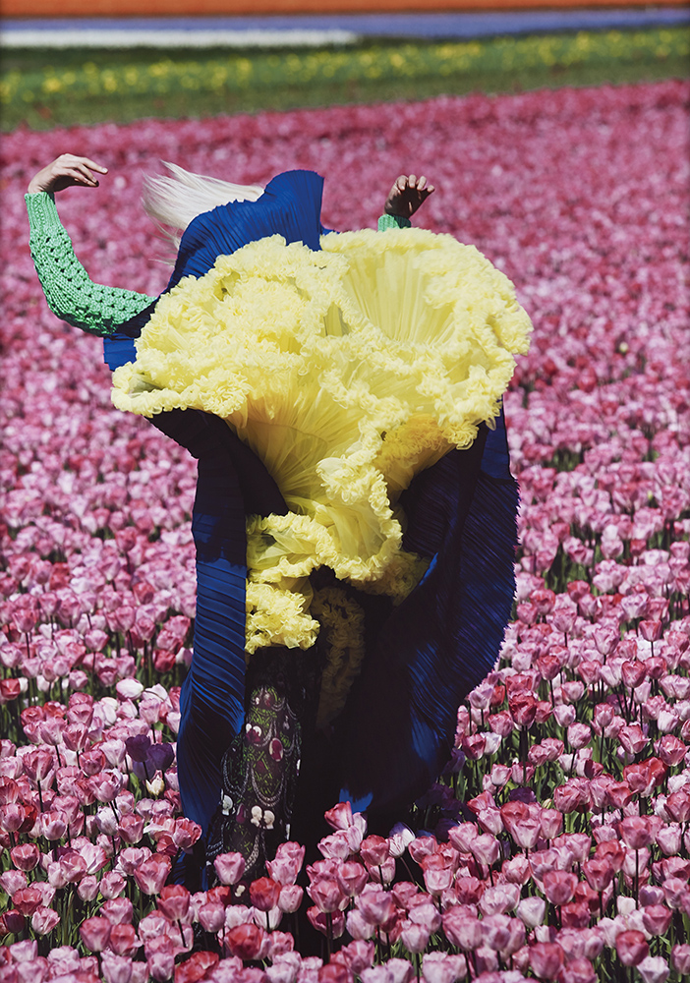
Good Art – who decides?
Session 1: What is good art?

Slide 2
Introduction
We will be exploring ideas together.
It is important to think, talk and listen.
We are not looking for a specific answer. Your opinion is important.

Slide 3
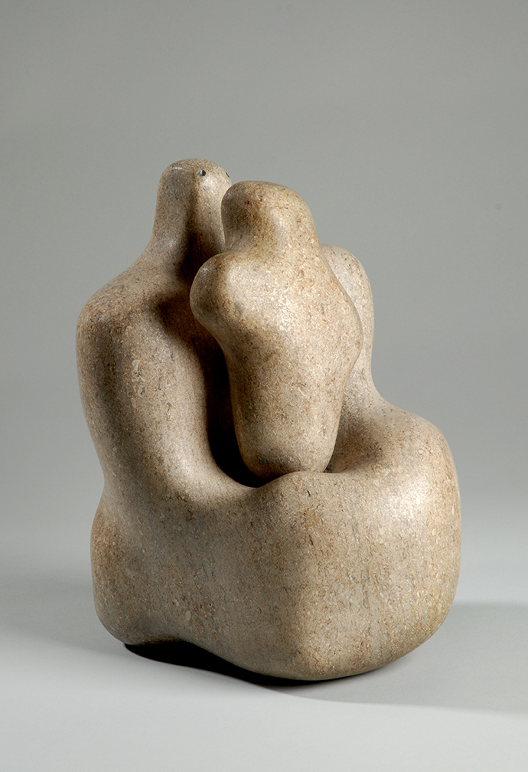
Part 1 What is art?
Look around the room.
What kind of art can you see?
Notes:
Ask the group to list all the types of art they can see.
Encourage them to consider – their clothes, jewellery, hairstyles, computer devices, phones, furniture, the architecture, as well as any pictures, signage, or 3D objects in the room. All of these have been designed by an artist / designer / craftsperson. Are they all art?

Slide 4
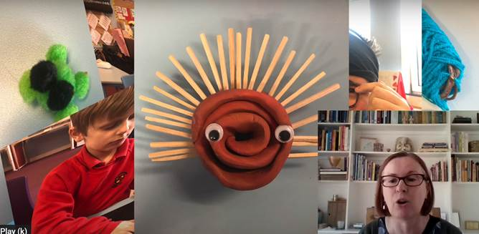
Part 1 What is art?
Watch this video: Making Sense of Art
Do you agree or disagree with anything that is said in the video? Why?
Notes:
Give students time to chat to each other in small groups, then repeat as a whole class discussion.
Nested questions:
Can the stars in the sky be art?
How do you feel when you make art?
Have you ever been to a gallery?
Why do we have galleries?

Slide 5
Part 2 Favourites
Get into groups of about 4
Look at the images on your table
Rank the images in order, with your favourite at the top, down to your least favourite at the bottom
Notes:
Get into groups of about 4.
Give each group a print out of the above images. Tell them that they will see a variety of artworks made by different artists. (6 of them are by the artist Barbara Hepworth).
Ask them to rank their favourite artworks by ordering printouts physically on their tables.
Tell them they should discuss with their group their reasons for their favourite and their least favourite (10 minutes).
Optional extra:
Ask them to rank again, this time from most to least original / memorable / funny / thought-provoking.

Slide 6
6

Slide 7
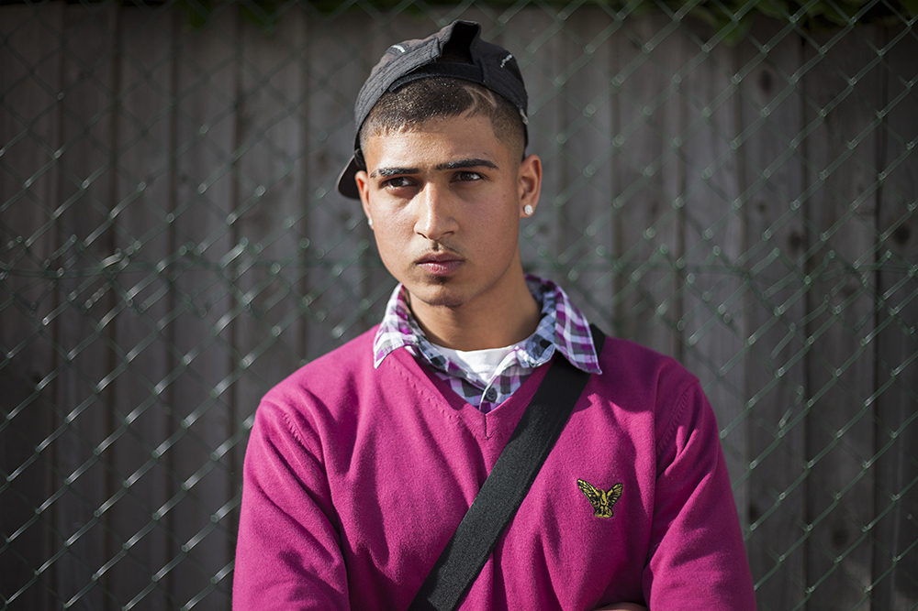
Part 2 Favourites
Discuss in your groups the reasons for your favourite and least favourite

Slide 8
Part 2 Favourites
Pick one of these options:
Class discussion
Carousel Activity

Slide 9
Part 2 Favourites
Group Discussion
Which image is the best art?
Notes:
Ask students ‘Which image is the best art?’. Explain that they can share their personal opinion OR the group decision.
Write their reasons as a list on the board (e.g. they might say things like X is the best because the artist put effort into/ X is colourful and is more alive/ X is a painting and painting is art)
Possible emergent questions
What is the difference between art and photography?
Is painting better than photography?
Does the material that art is made from matter?
Does good art require:
Details
The artist spending lots of time on it
The artist using lots of effort to make it
Being unique / colourful / memorable / funny
An interesting idea
That it’s made by humans/without a machine
That it makes you think / feel / ask questions / wonder/ see things differently?
Somebody paid a lot of money for it?
Does an artwork get better the longer the artist spends making it?
Does it matter where you see the art (eg in a gallery or in the street)?

Slide 10
Part 2 Favourites
Group Discussion
Look at the list of reasons written on the board.
Do you agree or disagree with any of the reasons?
Notes:
Ask students to talk in pairs for two minutes about whether they disagree with any of the reasons on the board.
Have a whole class discussion about the disagreements, try to focus on one particular idea and have a more detailed discussion about that by asking students to explain their ideas and ‘iffing’ the question or checking for consistency e.g.
‘If a sculpture/photo takes as long to make and as much effort as a painting, is it good art?’
‘If the paintings are good art because they are colourful is every black and white image bad?’
Possible emergent questions
What is the difference between art and photography?
Does the material that art is made from matter?
Does an artwork get better the longer the artist spends making it?
Does good art require:
Details
The artist spending lots of time on it
The artist using lots of effort to make it
Being unique / colourful / memorable / funny
That it’s made by humans/without a machine
That it makes you think / feel / ask questions / wonder/ see things differently?
Somebody paid a lot of money for it?

Slide 11
Part 2 Favourites
Carousel Activity
Pick one person to represent your group.
Your representative will then visit other groups, explaining the reasons for picking your favourite and least favourite images.
Notes:
One person from each group is a representative who visits other groups, taking with them their group’s most and least favourite. Ask the representative to explain to each group what their group chose and why.
Announce the next rotation every 3– 5 minutes.
Possible emergent questions
What is the difference between art and photography?
Is painting better than photography?
Does the material that art is made from matter?
Does an artwork get better the longer the artist spends making it?
Does good art require:
Details
The artist spending lots of time on it
The artist using lots of effort to make it
Being unique / colourful / memorable / funny
An interesting idea
That it’s made by humans/without a machine
That it makes you think / feel / ask questions / wonder/ see things differently?
Somebody paid a lot of money for it?

Slide 12
Part 3 Socratic Circle
Do you think the group was good at having that discussion?
Create a drawing or painting to show your feelings about good art.
Notes:
Encourage them to consider which colours and marks could help show how they feel.
If there is time, you can ask a few students whether they want to show and explain their work.

Slide 13
Image credits:
Viviane Sassen, In Bloom, 2011 © Viviane Sassen
Hepworth, Genesis III, 1966 © Bowness. Photo: Jerry Hardman-Jones
Hepworth, Mother and Child 1934. Pink Ancaster stone. © Bowness. Photo: Jerry Hardman-Jones. Wakefield Council Permanent Art Collection (The Hepworth Wakefield). Purchased, 1951.
Hepworth, Robin Hood’s Bay, 1920 © Bowness.
Hepworth, Portrait of George Butler 1925 © Bowness.
Hepworth, Bust of Mrs. A. R. T. Richards (Quita) 1924-25 © Bowness.
Jim Lambie, ZOBOP 1999 © Jim Lambie. All Rights Reserved, DACS, London 2018.
Hepworth, The Shadow Dance 1919 © Bowness.
David Shrigley, Posters for Tram. 1997 © David Shrigley. All Rights Reserved. DACS, London 2021
Mahtab Hussain, Pink jumper, hair design, bling from the series You Get Me? 2010 © Mahtab Hussain

